Slide 1
Workshop Presentation
Exploring Quantum Physics and Quantum Computing
Global Quantum Project
Womanium 2023
Modern College of Professional Studies
Chaudhary Charan Singh University

Slide 2
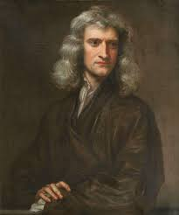
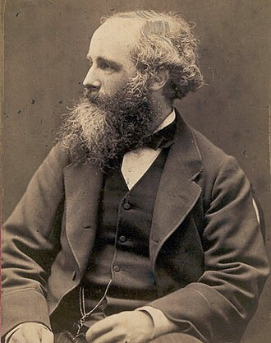
History
At the end of 19th century, physics consisted essentially of Newton’s Classical Mechanics and Maxwell’s theory of electromagnetism.
https://en.wikipedia.org/wiki/Isaac_Newton
https://en.wikipedia.org/wiki/James_Clerk_Maxwell
Sir Isaac Newton
James Clark Maxwell
The overwhelming success of classical physics and classical electromagnetic phenomenon made us believe that the ultimate description of nature has been achieved and every physical phenomenon can be explained in the general framework of radiation and matter.

Slide 3
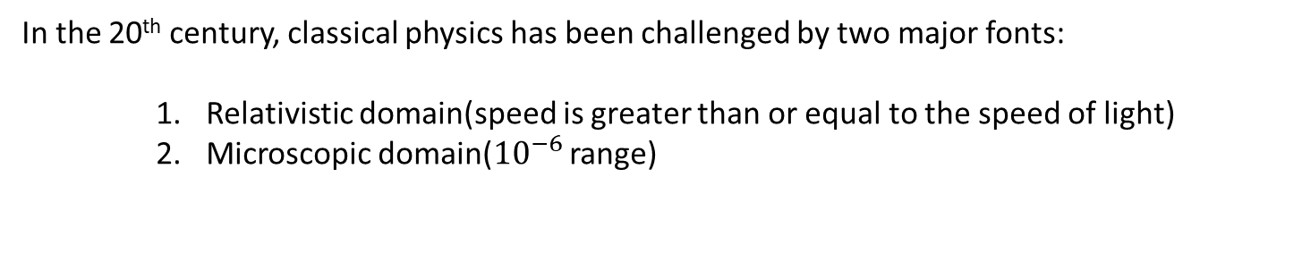
In the 20th century, classical physics has been challenged by two major fonts:
Relativistic domain(speed is greater than or equal to the speed of light)
Microscopic domain(${10}^{−6}$ range)
1900
Max Planck introduced the concept of quantization of energy to explain the phenomenon of Black body radiation.
1905
Einstein postulated that light is made up of discrete bits of energy called photons or quanta of energy.
1923
De-Broglie postulated that radiation exhibits both wave like and particle like properties.
E = h$θ$
E = h𝜗
Proven by Davisson and Germer experimentally in 1927.
All these progressions led the foundation of Quantum Mechanics.

Slide 4
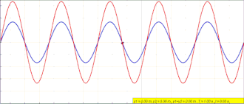
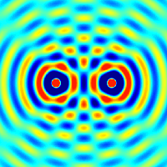

Interference
Interference is the phenomenon based on the superposition of two or more propagating coherent waves.
https://en.wikipedia.org/wiki/Wave_interference
Examples:
https://en.wikipedia.org/wiki/Wave_interference
Interference in water
Interference of two point sources

Slide 5
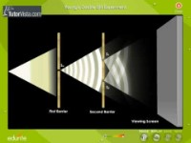
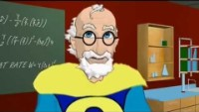
Double Slit interference with waves
What do you expect with particles?

Slide 6
Introduction to Quantum Physics
Quantum Mechanics: Real Black Magic Calculus
-Albert Einstein
“If you are not confused by quantum physics then you haven’t really understood it” –Neils Bohr
And Richard Feynman also remarked, “I can safely say that nobody understands quantum mechanics”

Slide 7
Conclusion
All the particles with mass show wave like properties.
All the information regarding their position and momentum is stored in the wave function.
The exact position of the particle cannot be predicted we can only talk in terms of probability.
State of the system is the superposition of all the possible state each with having a certain probability of occurrence.

Slide 8
Superposition
Superposition means linear combination of all possible states.
Entanglement
It is defined as “spooky action at a distance”.
Entangled bodies posses the property of unbreakable correlation between them.
The beauty of entanglement is that knowing the state of one particle automatically tells you something about its companion, even when they are far apart.

Slide 9
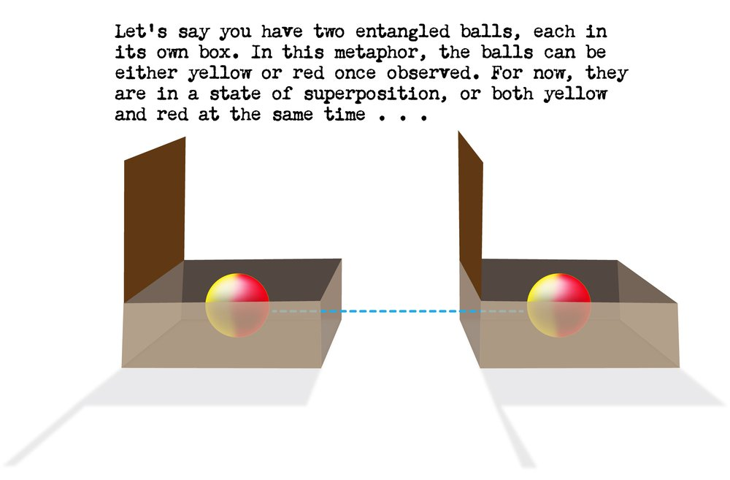
https://scienceexchange.caltech.edu/topics/quantum-science-explained/entanglement

Slide 10
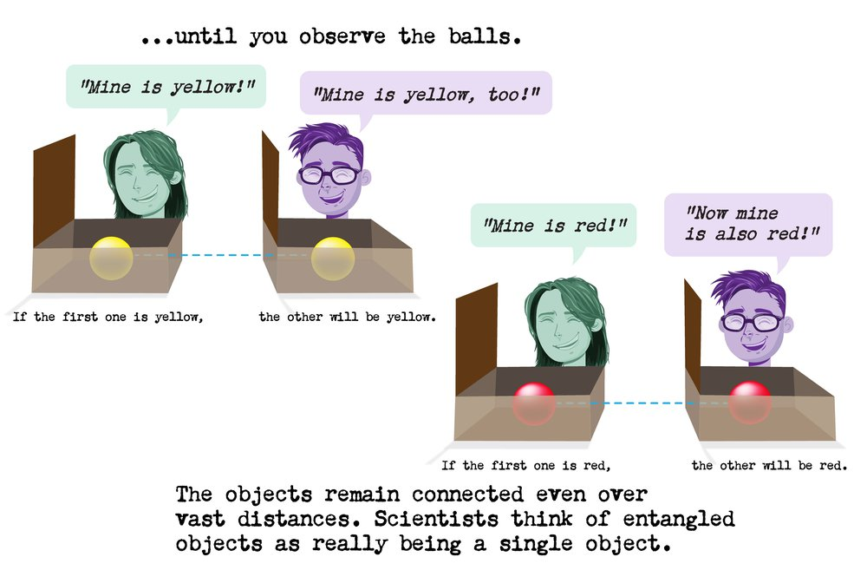
https://scienceexchange.caltech.edu/topics/quantum-science-explained/entanglement

Slide 11
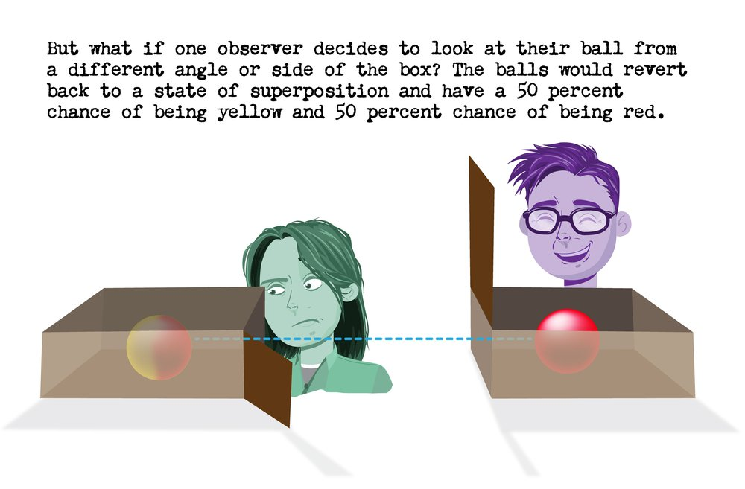
https://scienceexchange.caltech.edu/topics/quantum-science-explained/entanglement

Slide 12
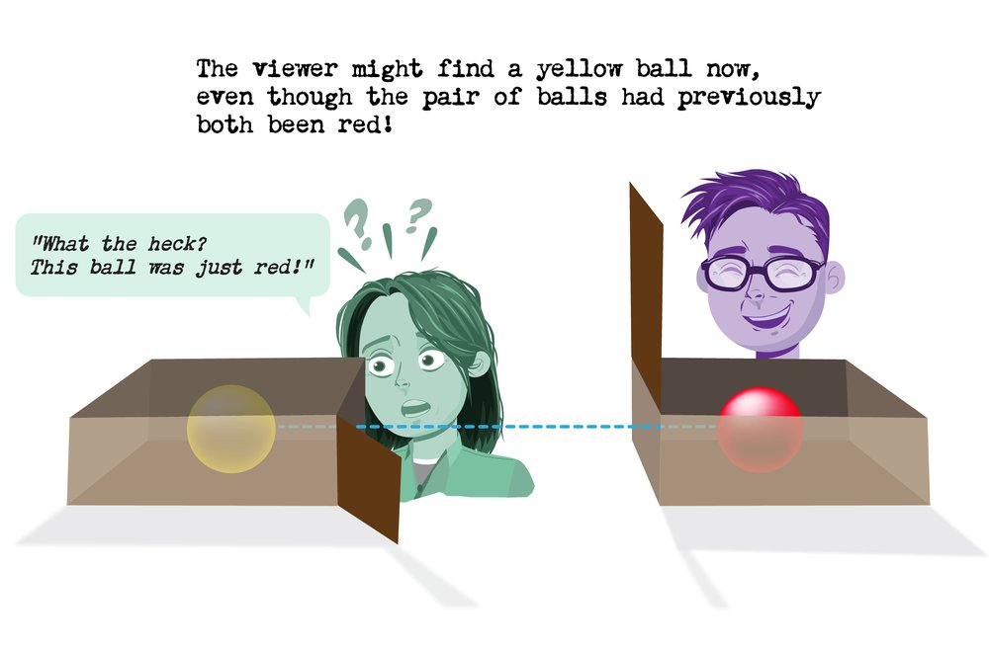
https://scienceexchange.caltech.edu/topics/quantum-science-explained/entanglement

Slide 13
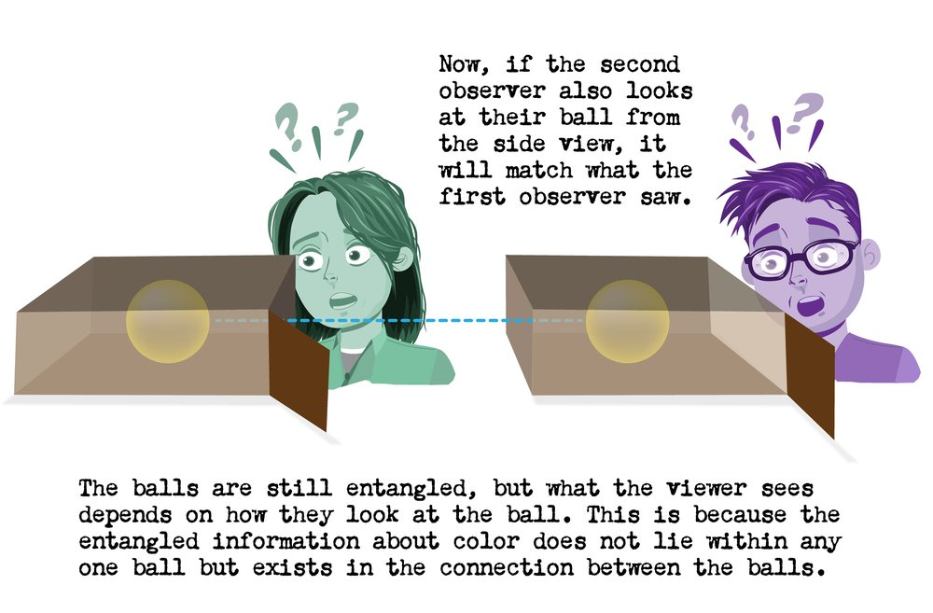
https://scienceexchange.caltech.edu/topics/quantum-science-explained/entanglement

Slide 14
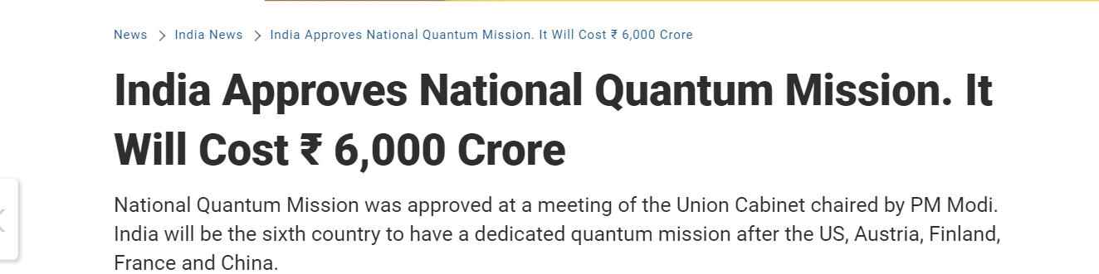
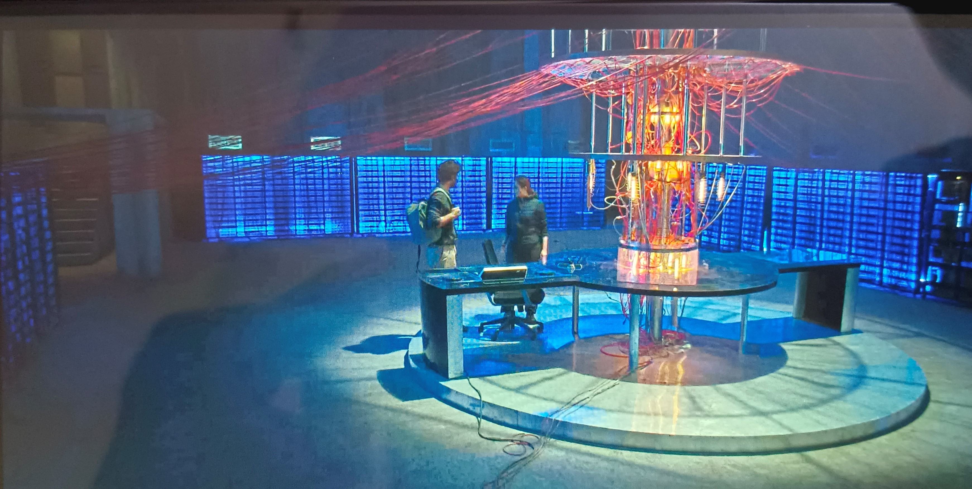
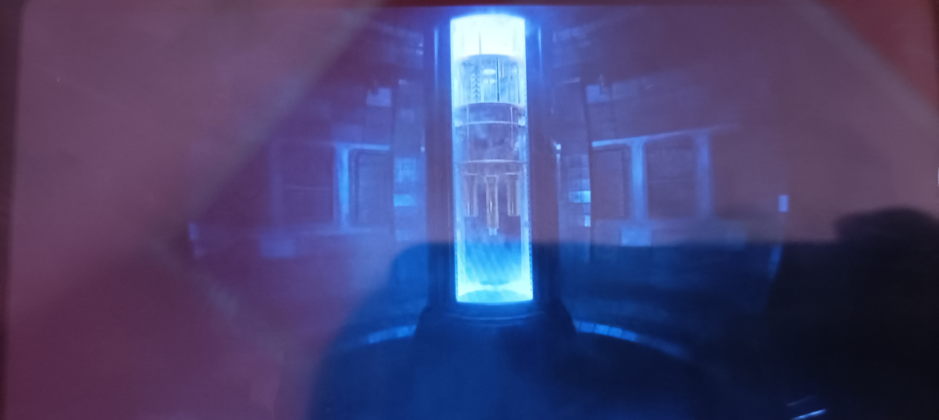
Quantum Computing and it’s power is in talk everywhere…..
Asur-2 last episode
From Heart of Stone movie 2023
Note: The concepts shown in the movies have nothing to do with real quantum concepts and they are just fictitious

Slide 15
Introduction to Quantum Computing
Quantum Computing completely relies on the phenomenon of interference and entanglement between quantum bodies.
A promising field that aims to go beyond scale of transistors to achieve more computational power and achieve better time complexity.
Solve problems which are harder for todays computers at your home and even large supercomputers like travelling salesman problem.
It has applications in various fields like medicine, machine learning and making research even for faster.

Slide 16
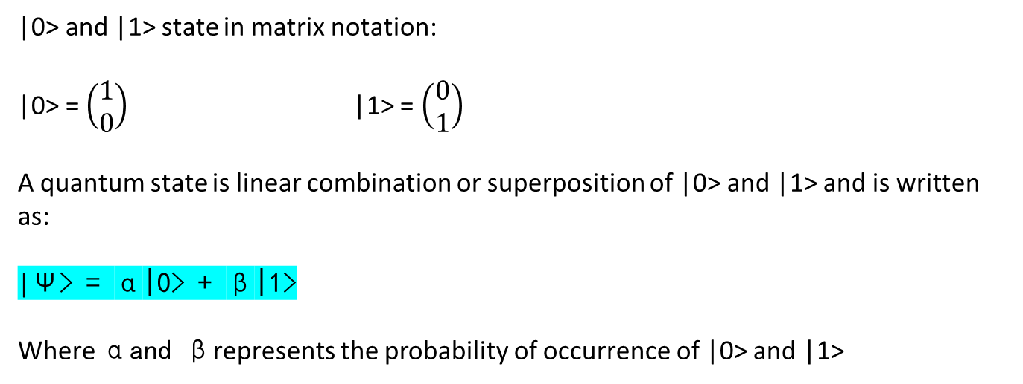
Dirac Notation
Bra-Ket notation is Dirac’s Notation
|A> (Ket Vector)
<B| (Bra Vector)
|0> and |1> state in matrix notation:
|0> = $\left(\begin{aligned}1 \\ 0\end{aligned}\right)$ |1> = $\left(\begin{aligned}0 \\ 1\end{aligned}\right)$
A quantum state is linear combination or superposition of |0> and |1> and is written as:
|Ψ> = α|0> + β|1>
Where αand βrepresents the probability of occurrence of |0> and |1>

Slide 17
Qubit
Quantum Bit i.e. basic building block of quantum computers as bit is of classical computer
It can be both |0> and |1> at the same time as exits in superposition.
Qubits are made from physical systems like superconductors, Si based qubits, neural atom, photons, ion-traps and many others.
Superconducting qubit are the celebrities of today as they are most talked about.
Measurement
Measurement destroys the state of the qubit and results in |0> and |1> with definite probabilities.
Measurement destroys the original state of the quantum system.

Slide 18
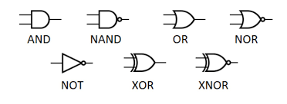
Classical Gates
https://www.google.com/search?sca_esv=559664296&rlz=1C1GCEA_enIN933IN933&sxsrf=AB5stBjTmjZOJrU4kdaRl7N81XYhhe65fA:1692866181126&q=classical+gate+computer%0Aclassical+gate+computer&tbm=isch&source=lnms&sa=X&ved=2ahUKEwjI_IL78fSAAxXh-jgGHcK5AIwQ0pQJegQIDhAB&biw=1536&bih=715&dpr=1.25#imgrc=1Z2SuRzNC-ZRDM

Slide 19
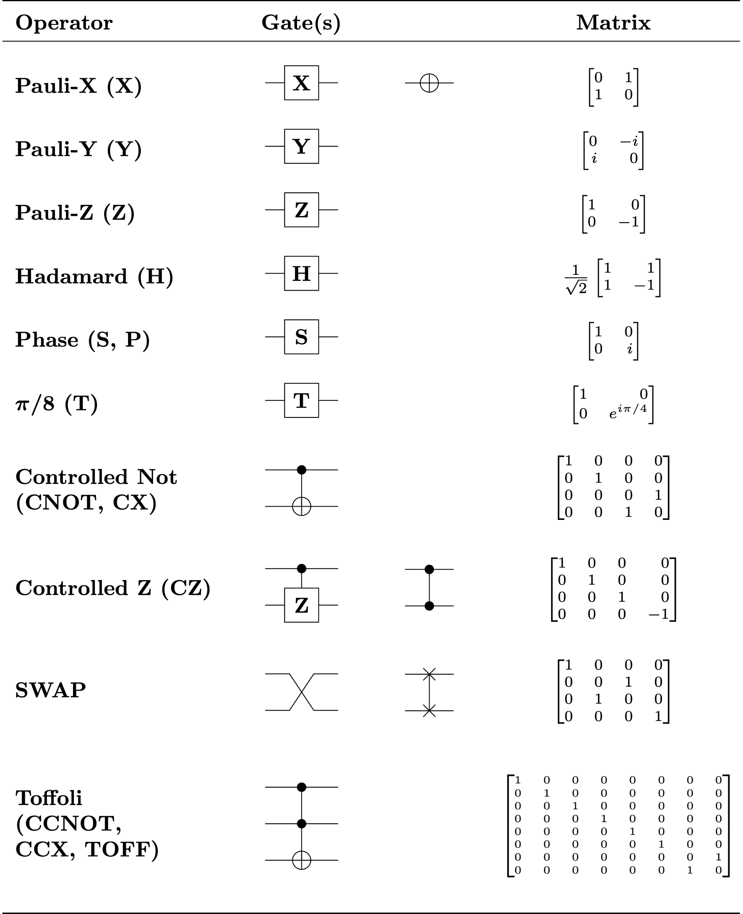
Quantum Gates

Slide 20
For solving:

Slide 21
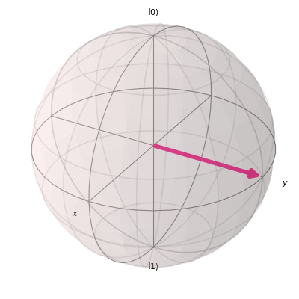
Bloch Sphere
State of a qubit is represented on a bloch sphere
https://qiskit.org/documentation/stubs/qiskit.visualization.plot_bloch_vector.html

Slide 22
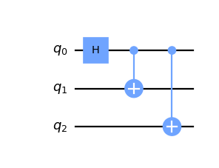
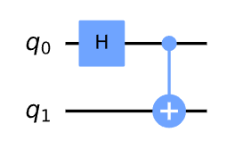
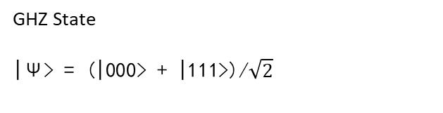
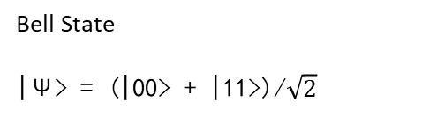
Quantum Circuits
Quantum Circuits are the collection of quantum gates connected with wire.
The actual structure of a quantum circuit, the number and types of gates, as well as interconnection scheme are dictated by unitary transformation, U, carried out tby the circuit.
Bell State
|Ψ> = (|00> + |11>)/$\sqrt{2}$
GHZ State
|Ψ> = (|000> + |111>)/$\sqrt{2}$
https://learn.qiskit.org/course/ch-gates/multiple-qubits-and-entangled-states
https://qiskit.org/documentation/apidoc/circuit.html

Slide 23
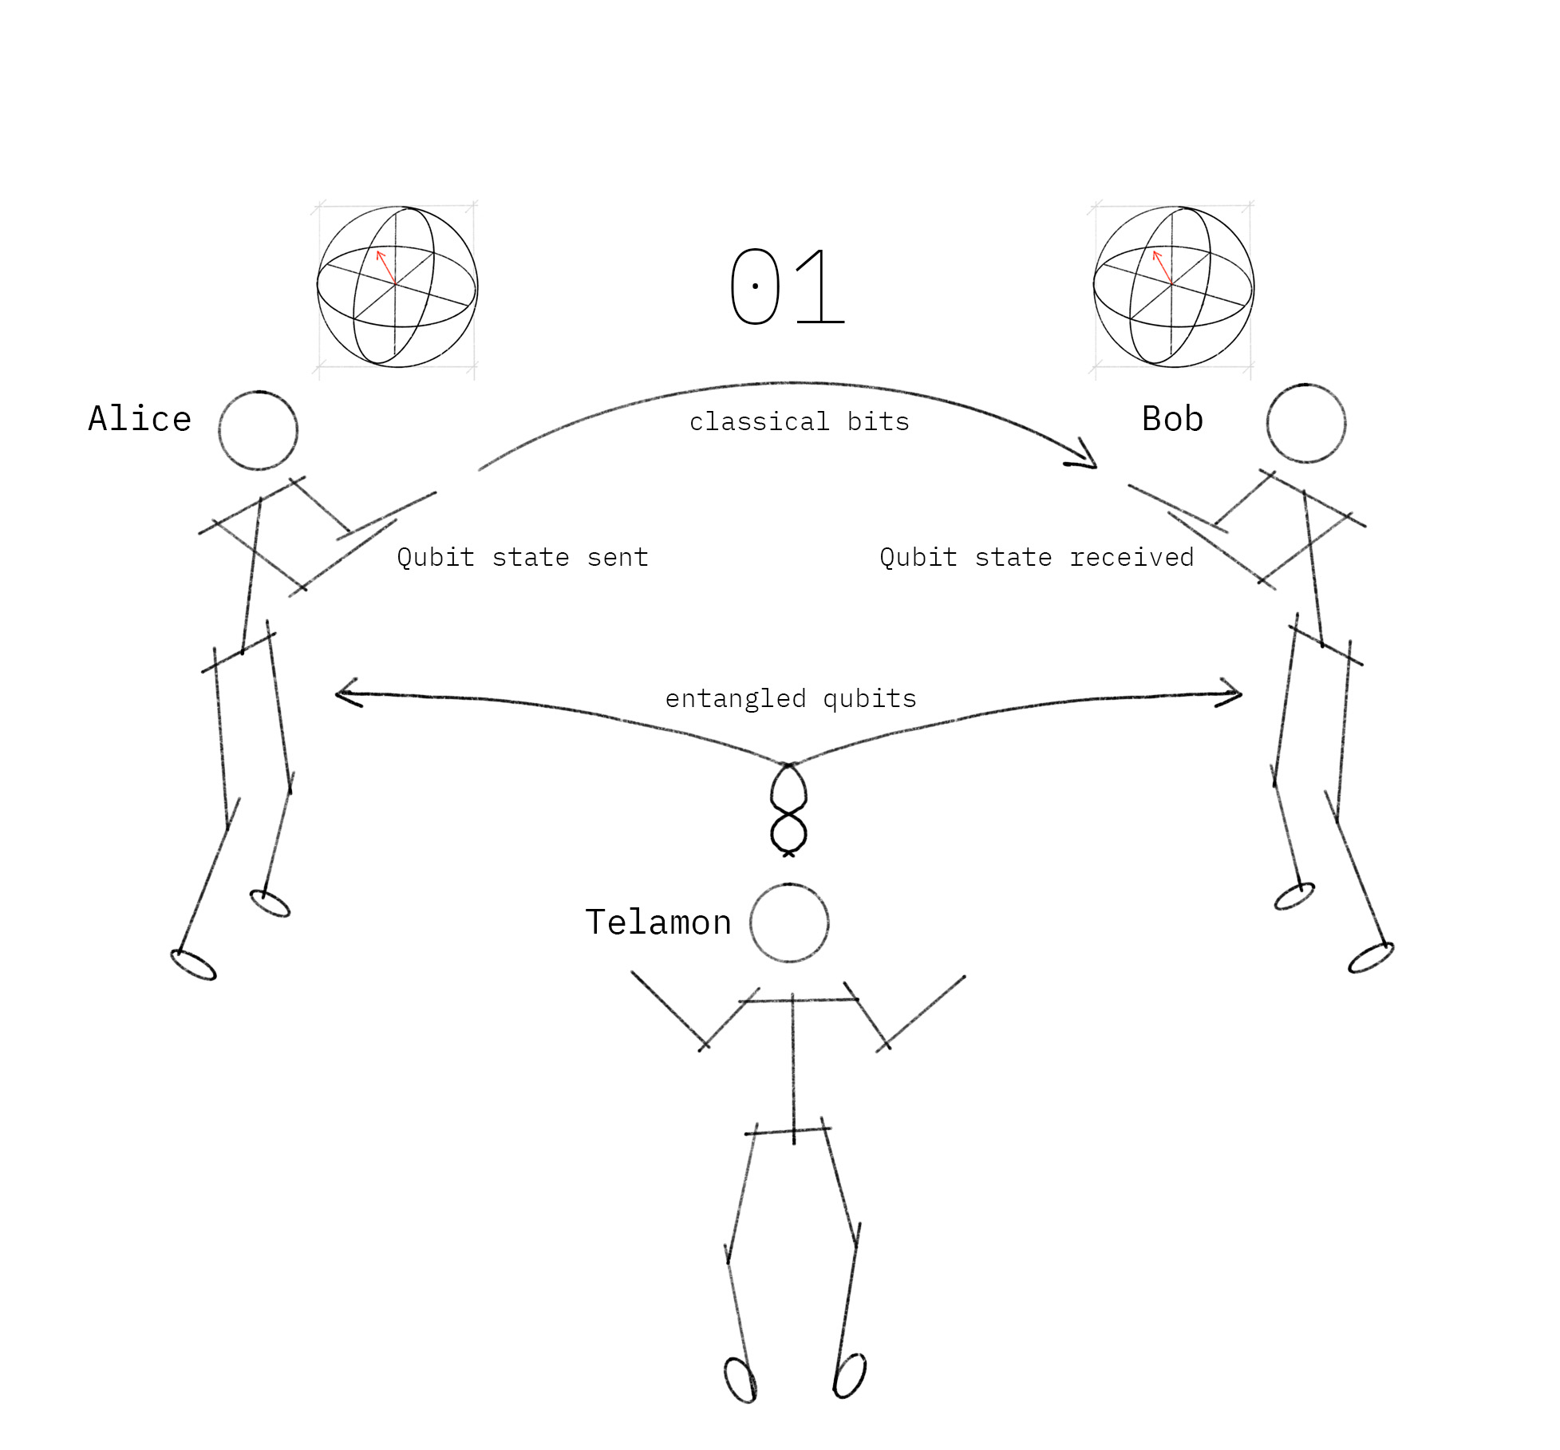
Algorithm: Teleportation
Transmission of quantum information on a classical channel.
https://learn.qiskit.org/course/ch-algorithms/quantum-teleportation

Slide 24
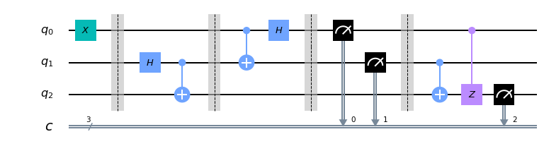
Teleportation Circuit
https://learn.qiskit.org/course/ch-algorithms/quantum-teleportation

Slide 25
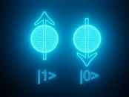
How qubits are made?
Today qubits are made using the following:
Electron
Neutral atom
Superconductors
Photons
Silicon-based qubits
Quantum annealers
Refers to electron spin
https://www.istockphoto.com/photos/electron-spin

Slide 26
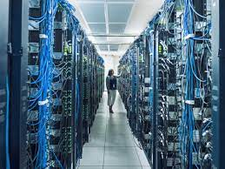
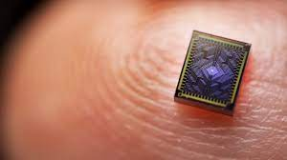
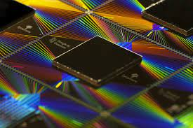
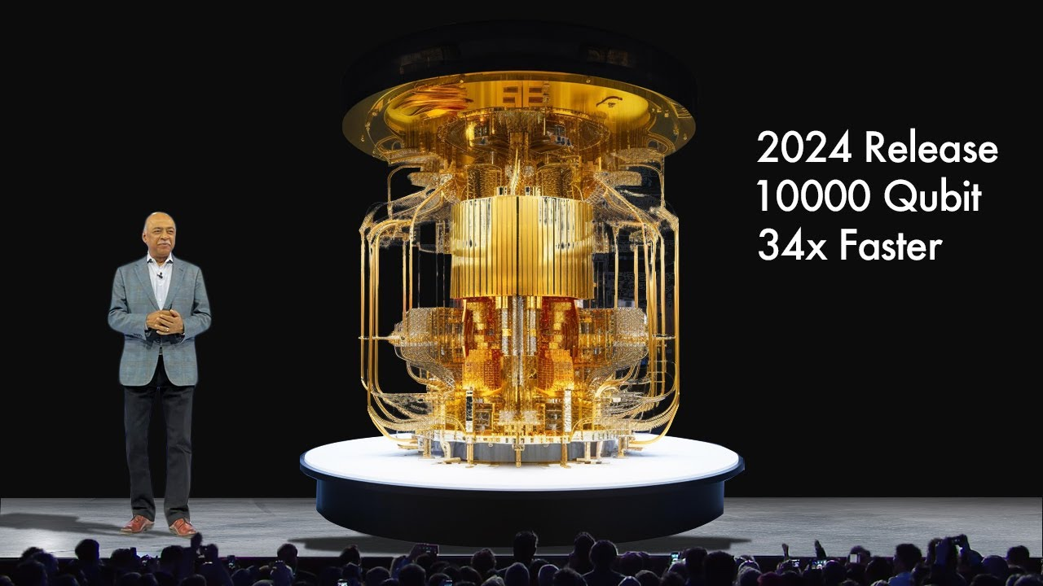
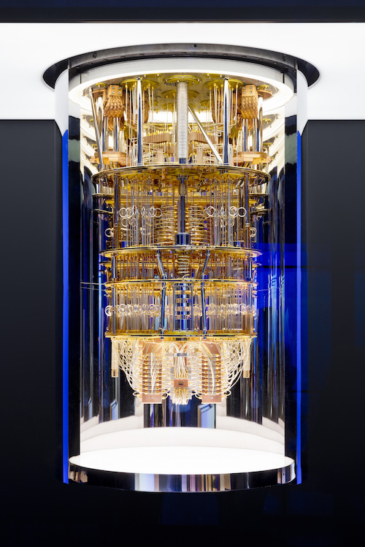
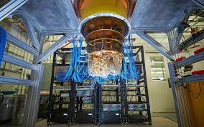
How Today’s Quantum Computers look like?
Quantum Chip
By IBM
https://www.youtube.com/watch?v=lY3jhUhVxK0
https://www.google.com/search?sca_esv=559674773&rlz=1C1GCEA_enIN933IN933&sxsrf=AB5stBjV6N3ryL7-GQmV1CUt_JQfk0iL5g:1692866850961&q=quantum+computing+rooms&tbm=isch&source=lnms&sa=X&ved=2ahUKEwixv7a69PSAAxXMGIgKHTwJAHgQ0pQJegQIDRAB&biw=1536&bih=715&dpr=1.25#imgrc=BXZpkNKKFweoaM

Slide 27
What makes quantum computing so challenging?
Qubit Decoherence: Qubits are extremely sensitive to there environment, and even small disturbances can cause them to loose there quantum properties.
Scalability: Irrespective of there impressive performance for some tasks, they are very less as compared to classical computers. Scaling up to thousands of qubits while maintaining high level of coherence and maintain low error rates still remains challenging.
Error Correction: Quantum Computers are extremely sensitive to noise and errors caused by the interaction with their environment. This can cause error to accumulate and degrade the quality of computation. So, developing error correcting techniques is crucial for practical quantum computing.
Hardware Development: Developing high quality quantum hardware, such as qubits and control electronics is a major challenge.
Software Development: Quantum algorithms and software tools are still in their infancy, and there is need for new programming languages, compilers and optimizations tools to utilize the power of quantum computers.
https://thequantuminsider.com/2023/03/24/quantum-computing-challenges/

